Slide 1

Cross-Platform Mobile Development in Visual Studio

Slide 2

MARQUEE SPONSOR

Slide 3

PLATINUM SPONSOR

Slide 4

PLATINUM SPONSOR

Slide 5
PLATINUM SPONSOR

Slide 6




GOLD SPONSORS

Slide 7








SILVER SPONSORS

Slide 8
Cross-Platform Mobile Development in Visual Studio

Slide 9
Who Am I?
Bart Read, Software Engineer, Red Gate Software
Working on Nomad for Visual Studio - http://vsnomad.com/
bart.read@red-gate.com
Twitter: @bart_read
https://github.com/bartread

Slide 10
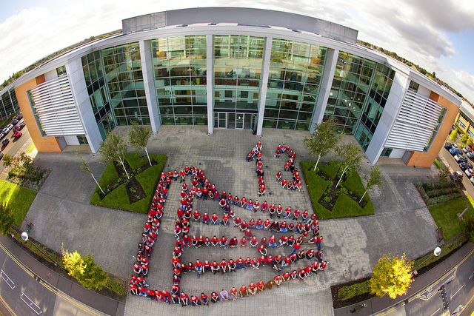

Slide 13

BUSTED!

Slide 14



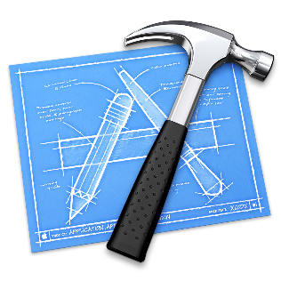




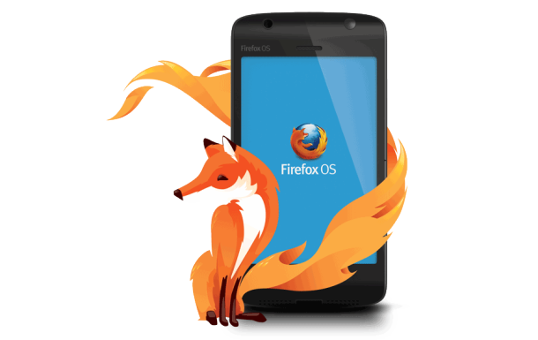







Slide 15
These options all boil down to…
Native
Hybrid
Mobile Web
Other/Fringe/Exotically Proprietary

Slide 16
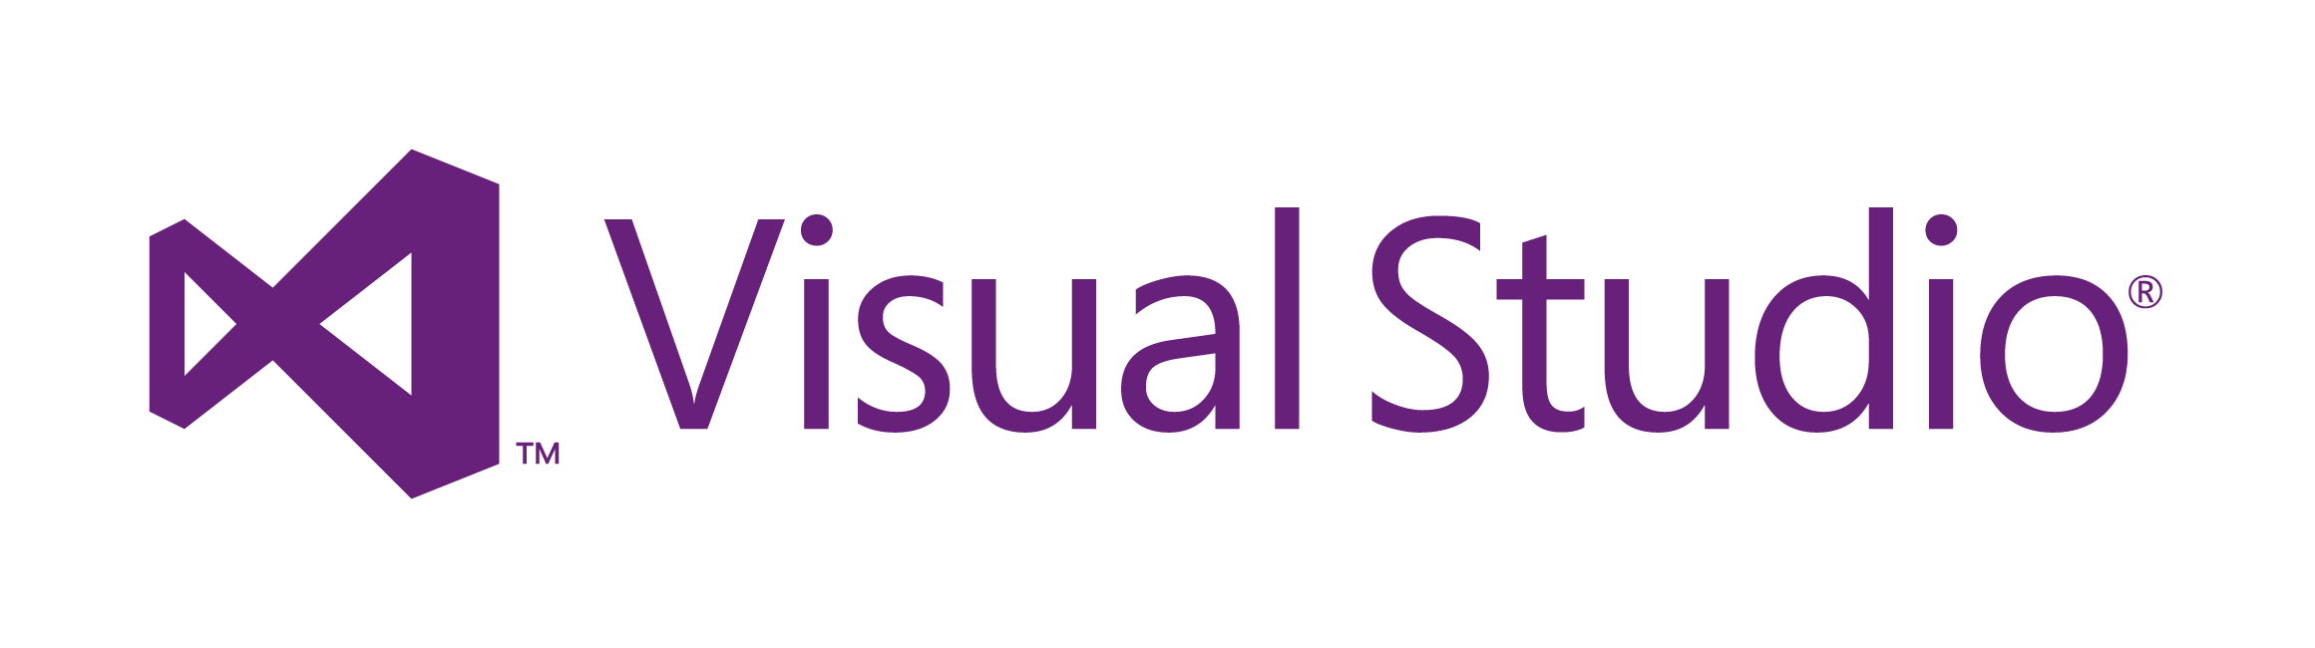

Slide 18
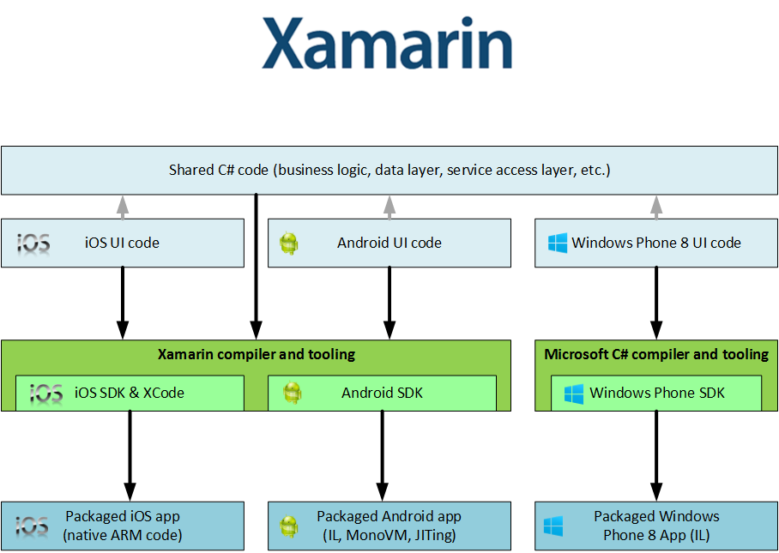

Slide 19
Pros
Cons
C#
Native look
Near-native performance
Full access to native APIs
More code; less sharing
Maintenance
Need to know native APIs
Platform quirks
Need Mac to build for iOS
Use for: performance, native experience

Slide 20



Slide 21
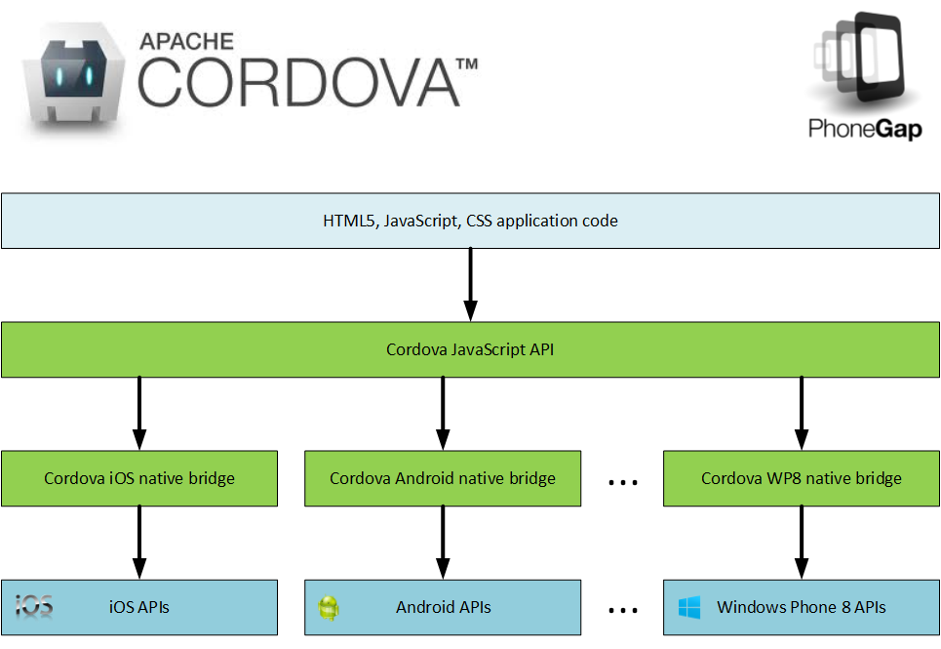

Slide 22
The Cordova JavaScript API
Accelerometer Camera
Capture Compass
Connection Contacts
Device Events
File Geolocation
Globalization InAppBrowser
Media Notification
Splashscreen Storage
Plug-ins: https://github.com/phonegap/phonegap-plugins

Slide 24
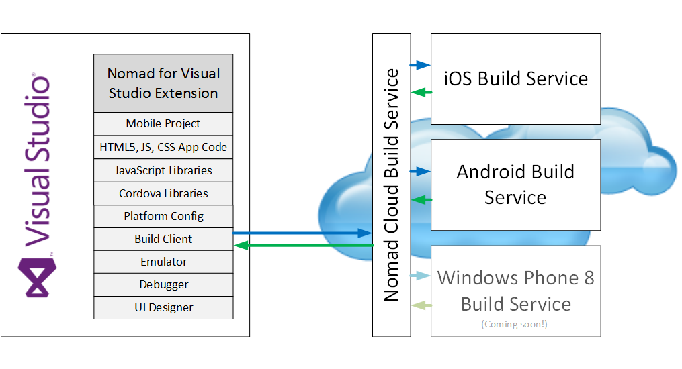

Slide 25
Pros
Cons
HTML5/JavaScript/CSS
Write once for all platforms
Simple, unified device API
Simple setup
Don’t need a Mac*
Future-proof; no lock-in
Non-native UX
Performance
No great Windows solution**
Use for: simplicity, delivery time, maintenance

Slide 26

But wait: why not just use mobile web instead?

Slide 27
Windows Phone 8 and Windows 8/RT Development Resources
http://msdn.microsoft.com/en-us/library/windowsphone/develop/jj681690(v=vs.105).aspx - Windows Phone 8 and Windows 8 platform comparison
http://msdn.microsoft.com/library/windowsphone/develop/jj714089(v=vs.105).aspx - Windows Phone 8 and Windows 8 app development
http://msdn.microsoft.com/en-us/library/windowsphone/develop/jj721614(v=vs.105).aspx - Handling Windows Phone 8 and Windows 8 platform differences
http://channel9.msdn.com/Series/Building-Apps-for-Both-Windows-8-and-Windows-Phone-8-Jump-Start - Channel 9 - Building Apps for Both Windows 8 and Windows Phone 8 Jump Start

Slide 28

Demo Time!

Slide 29


Slide 30


Slide 31


Slide 33
Coming soon to Nomad…
On-device debugging
A FREE version of the service
Cordova plug-in support
PushNotification
BarcodeScanner
Etc., see https://github.com/phonegap/phonegap-plugins
Windows Phone 8 support

Slide 34
Contacts & Resources
Nomad for Visual Studio - http://vsnomad.com/
bart.read@red-gate.com
Twitter: @bart_read
https://github.com/bartread
Using Nomad to create an app with Azure Mobile Services: http://www.codeproject.com/Articles/585792/Android-and-iOS-Mobile-Device-Development-with-Azu

